Slide 1
ITIL® 2011 Foundation Certification Course
Unit 6—Continual Service Improvement

Slide 2
Continual Service Improvement (CSI)
Lesson 1 – Introduction to CSI

Slide 3
Objectives
Describe the purpose, objective and scope of CSI
Explain the value of CSI to improve business
After completing this lesson, you will be able to:

Slide 4




CSI–Purpose
CSI is applicable throughout the entire service lifecycle.
The purpose of CSI is to:
align IT services with changing business needs by identifying and implementing improvements and processes that support the business; and
improve effectiveness, efficiency and economics of all processes associated with delivering services.
Purpose
Objective
Scope
Scope
Value

Slide 5


CSI–Objective
The objective of CSI is to:
review, analyse, prioritise and make the recommendations on improvement and opportunities in each lifecycle stage;
review and analyse service level achievement; and
identify and implement specific activities to improve IT service quality and improve the efficiency and effectiveness of the enabling processes.
Purpose
Objective
Scope
Value

Slide 6
CSI–Scope
The scope of CSI is to:
maintain overall health of ITSM including dependent services;
align continually the service portfolio with business needs;
help in maturing the service after implementing and operating the processes; and
improve all aspects of IT service and service assets.
Purpose
Objective
Scope
Value

Slide 7
CSI–Value for Business
Applying standard and consistent processes for CSI will:
provide a gradual and continual improvement in service delivery;
ensure IT services are continuously aligned to business needs;
result in improvements in cost effectiveness through decrease in costs and/or the capability to handle more work at the same cost;
identify opportunities for improvement in all lifecycle stages and in all processes; and
recognise openings for changes in organisational structures, resourcing capabilities, partners, technology, staff skills and training, and communications.
Purpose
Objective
Scope
Value

Slide 8
Summary
CSI aligns and improves the IT services that supports the business needs.
CSI is applicable throughout the service lifecycle.
The scope of CSI is to maintain overall health of ITSM
Adopting and implementing standard and consistent approaches for CSI will lead to better business results.
Here is a quick recap of what we have learnt in this lesson:

Slide 9
Continual Service Improvement (CSI)
Lesson 2 – Key Principles and Models

Slide 10
Objectives
Describe the key concepts and principles related to CSI.
Explain the seven-step improvement process.
Explain the model behind continual service improvement.
After completing this lesson, you will be able to:

Slide 11
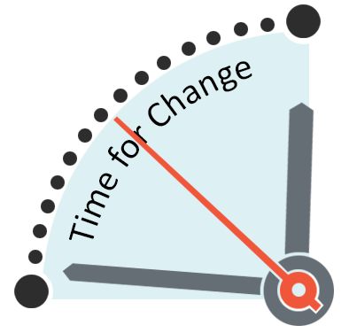
CSI and Organisational Change
Organisational changes are required for CSI. These changes lead to many challenges. The success of a CSI program depends on the buy-in of all stakeholders.
Approaches that improve the success of a CSI program are:
John P. Kotter’s Eight Steps to Transforming your Organisation; and
Project management services and practices.

Slide 12
CSI Register
CSI register records all the improvement opportunities and categorises them based on complexity and size. The CSI Manager is accountable and responsible for this register.
Following are the benefits of the CSI Register:
It contains important information for the overall service provider and is a critical part of Service Knowledge Management System (SKMS).
All service improvement related initiatives are captured and recorded. The initiatives are monitored through the CSI register to ensure that the benefits are realized.
It provides a coordinated and consistent view of various improvement initiatives.

Slide 13
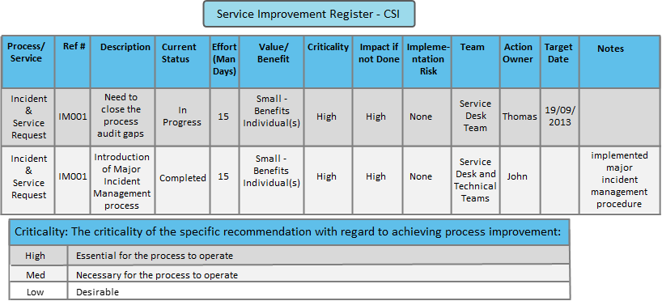
CSI Register
The following is a sample CSI register.

Slide 14

Service Measurement
Predicting and reporting service performance of an end-to-end service against targets is called Service Measurement.
To enable service measurement, data is collected from the individual measurements and combined to provide a view of the customer experience.
Data is analysed over a period of time to produce a trend.
Data can be collected at multiple levels (for example, configuration items, components, processes and services).

Slide 15
CSI—Monitor and Measure
CSI uses the results of all measurements to identify and establish improvements.
Following are the four primary reasons to monitor and measure process metrics:
To validate: This is to answer the question, “Are we supporting the strategy and vision?”.
To direct: This is to monitor and measure the metrics set for activities in order to meet the defined targets.
To justify: This is to monitor and measure process metrics with factual evidence or proof to get a required course of action.
To intervene: This is to take corrective actions such as identifying improvement and opportunities.

Slide 16




CSI—Monitor and Measure (contd.)
The image shows the four reasons why monitor and measure metrics.
Targets
Strategy Vision
and
Metrics
To Validate
To Direct
Your Measurement Framework
IT performance
Functional Evidence
Changes, Corrective Actions
To Justify
To Intervene

Slide 17
Types of Metrics
Metrics is a standard of measurement that can be used to help manage a process, IT service or activity. There are three types of metrics an organisation needs to support. These are:
Technology metrics
Associated with component and application-based metrics such as performance, availability and so on.
Several design architects and technical specialists are responsible for defining it.
Process metrics
Captured in the form of Critical Success Factors (CSFs), Key Performance Indicators (KPIs) and activity metrics for IT Service Management (ITSM) processes.
CSI uses these metrics to identify improvement opportunities for each process.
Service metrics
Indicates the results of the end-to-end service. Component metrics are used to calculate the service metrics.
Service Level Managers and Service Owners are responsible for defining appropriate service metrics.

Slide 18



CSI–Measurement and Metrics
CSI measurement and metrics consist of the following:
Critical Success Factors (CSFs)
Key Performance Indicators (KPIs)
Baselines
While CSF and KPI are process metrics used to identify improvement opportunities for each process, baseline is used as a reference point for later comparison.

Slide 19
CSF and KPI─Examples
A few examples of CSFs and KPIs of CSI are as follows:
Example 1
Example 2
3% reduction in failed changes; 10% reduction in security breaches
CSF: All improvement opportunities identified
KPI: Percentage improvement in defects
2.5% reduction in the average cost of handling an incident; 5% reduction in the cost of processing a particular type of transaction
CSF: The cost of providing services is reduced
KPI: Percentage decrease in overall cost of service provision

Slide 20
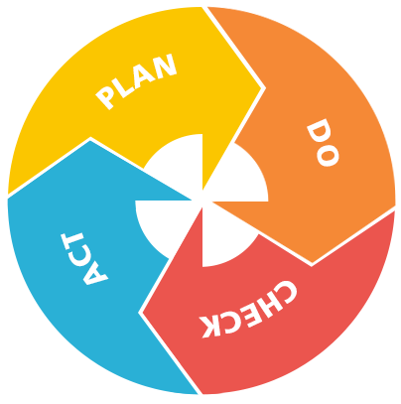
CSI: PDCA–Deming Cycle
W. Edwards Deming designed the PDCA (Plan Do Check and Act) model and suggested four key stages of improvement. The four stages of the PDCA model are:
Establish the objectives and processes required to deliver results in accordance with the customer needs and the organisation's policies.
Implement the processes.
Take actions to continually improve process performance.
Monitor and measure processes and product against policies, objectives and requirements for the product and report the results.

Slide 21
PDCA-CSI—Example
Step-1 Identifying the Strategy
Step-2 Define what will be measured
Step-3 Gather the Data
Step-4 Process the Data
Step-5 Analyse the Information
Step-6 Present and Use the Data
Step-7 Improvement Implementation
Validation of the Business Outcomes
Identify the parameters which are badly hit. Here lets take it as soft skills.
All the parameters related to soft skills like Hold time. Presenting Skills, Communication.
Q
Gather all the CSAT survey results for the month including the positive ones.
A Telecom organisation provides customer care services to its customers. As a continual improvement process, it conducted a survey on the customers who called in one month period. It assessed on the parameters, such as Welcoming, soft skills, Product Knowledge, Ability to resolve the issues, Wait time, etc. The CSAT results were unfavorable, therefore, the management plans to implement improvement in their process. The CSI Manager implements an approach to improve CSAT. The following process will help you understand the PDCA act implementation.
To remove all the data which are not in scope and arrange the data to have some information from it.
Analyse the data for the hit in the max parameter like Call duration, Call time, Agents Name.
Use the data to plan the improvement action like soft skills training, Motivating the callers for long calls.
Provide Soft skills training, Motivate callers with certificates for good score on soft skills.
Check for the outcomes after a month of implementation. Continue this process for improvement.

Slide 22
Seven-Step Improvement Process—Overview
The purpose of the seven-step improvement process is to define and manage the steps needed to identify, define, gather, process, analyse, present and implement improvements.
The objectives are to:
identify opportunities for improving services, processes, tools and so on;
reduce the cost of providing the services and ensuring that IT services enable the required business outcomes to be achieved;
identify what needs to be measured, analyzed and reported to establish improvement opportunities;
review service achievements to ensure they remain matched to business requirements, continually aligning service provision with outcome requirements; and
understand what to measure and why it is being measured, and carefully define the successful outcome.

Slide 23
Seven-Step Improvement Process—Scope
The scope of the seven-step improvement process is to:
analyse the performance and capabilities of services, processes throughout the lifecycle, patterns and technology;
align the portfolio of IT services with the current and future business needs as well as the maturity of the enabling IT processes for each service;
use the technology that the organisation has and exploit new technology as it becomes available where there is a business case for doing so;
assess the organisational structure and the capabilities of the personnel; and
ask whether people are working in appropriate functions and roles, and if they have the required skills.

Slide 24

Seven-Step DIKW Model
The seven-step DIKW Model is a derivative of the PDCA cycle.
Wisdom
Step 1
Identify the strategy for improvement
Step 2
Define what you will measure
Data
Business
outcomes
Plan
Do
Check
Act
Step 3
Gather the data
Step 7
Implement improvement
Step 4
Process the data
Step 6
Present and use the information
Step 5
Analyse the information and data
Knowledge
Information

Slide 25
CSI Model
CSI Model provides the basis for improvement of services and capabilities of an IT Service Provider.
What is the vision?
Business vision, mission goals and objectives
A company wants to achieve 95% customer satisfaction.
Where are we now?
Baseline assessments
It has achieved 44% customer satisfaction.
How do we keep the momentum going?
The company wants to achieve 65% as a practical target.
Where do we want to be?
Measurable targets
By implementing process improvements.
How do we get there?
Service and process improvements
Measure the improvement.
Did we get there?
Measurement and metrics
It has to keep the motivation up and continue the same.

Slide 26
CSI Overall Approach—Example
Q
A Telecom organisation provides customer care services to its customers. As a continual improvement process, it conducted a survey on the customers who called in one month period. It assessed on the parameters, such as Welcoming, Soft Skills, Product Knowledge, Ability to resolve the issues, Wait time, etc. The CSAT results were 67% and the SLA was 95%. The management, being unhappy about the results, has asked the CSI Manager to implement an approach to improve CSAT. The following process will help you understand the overall approach of CSI.
What is the vision?
CSAT must be 95%
Goals and Objectives
Where are we now?
CSAT Score - 67%
Current CSAT
How do we keep the momentum going?
By motivating the team and sharing the results from the improvement
Where do we want to be?
CSAT Score - 70%
Measurable Target — This has to be practical and we have to increase step by step
How do we get there?
PDCA and 7 Step improvement process
Implementing the Process/Service Improvements
Did we get there?
Did we acheive 70%?
Results after the Implementation

Slide 27
Summary
There are three types of metrics – technology, process and service.
CSI measurement and metrics consist of Critical Success factors, Key Performance Indicators and baselines.
The PDCA (Plan Do Check and Act) Model suggests the stages of improvement.
The purpose of the seven step improvement process is to define and manage the steps needed for improvement.
The CSI Model provides the basis for improvement of services and capabilities of an IT Service Provider.
Here is a quick recap of what we have learnt in this lesson:

Slide 29
Which of the following does CSI provide guidance on?
1
Improving process efficiency and effectiveness
Improving IT strategies
Improvement of all phases of the security lifecycle
Improving international standards such as ISO 20000

Slide 30
Which of the following does CSI provide guidance on?
1
Improving process efficiency and effectiveness
Improving IT strategies
Improvement of all phases of the security lifecycle
Improving international standards such as ISO 20000
Answer: a.
Explanation: CSI provides guidance on improving process efficiency and effectiveness.

Slide 31
Which of the following is not a metric described in CSI?
2
Process Metric
Personnel Metric
Service Metric
Technology Metric

Slide 32
Which of the following is not a metric described in CSI?
2
Process Metric
Personnel Metric
Service Metric
Technology Metric
Answer: b.
Explanation: The three metrics of CSI are process, service and technology. Personnel Metric is not a type of metric.

Slide 33
Learning and improvement is the primary concern of which of the following phases of the service lifecycle?
3
Continual Service Improvement
Service Strategy and Service Design
Service Strategy, Service Transition and Service Operation
Service Strategy, Service Design, Service Transition and Service Operation

Slide 34
Learning and improvement is the primary concern of which of the following phases of the service lifecycle?
3
Continual Service Improvement
Service Strategy and Service Design
Service Strategy, Service Transition and Service Operation
Service Strategy, Service Design, Service Transition and Service Operation
Answer: a.
Explanation: The CSI lifecycle takes care of learning and improvement.

Slide 35
Which is the third stage of the PDCA model?
4
Establish objectives and processes
Take actions to improve process performance
Implement the processes
Monitor and measure processes and products

Slide 36
Which is the third stage of the PDCA model?
4
Establish objectives and processes
Take actions to improve process performance
Implement the processes
Monitor and measure processes and products
Answer: d.
Explanation: Monitoring and measuring processes and products is the third stage of the PDCA model.

Slide 37
ITIL® is a registered trade mark of AXELOS Limited
IT Infrastructure Library is a registered trade mark of AXELOS Limited
AXELOS® is a trade mark of AXELOS Limited

